Slide 1
Research Groups: Pluses and Pitfalls
Enlish as Intermediary Component in Science Activity

Slide 2
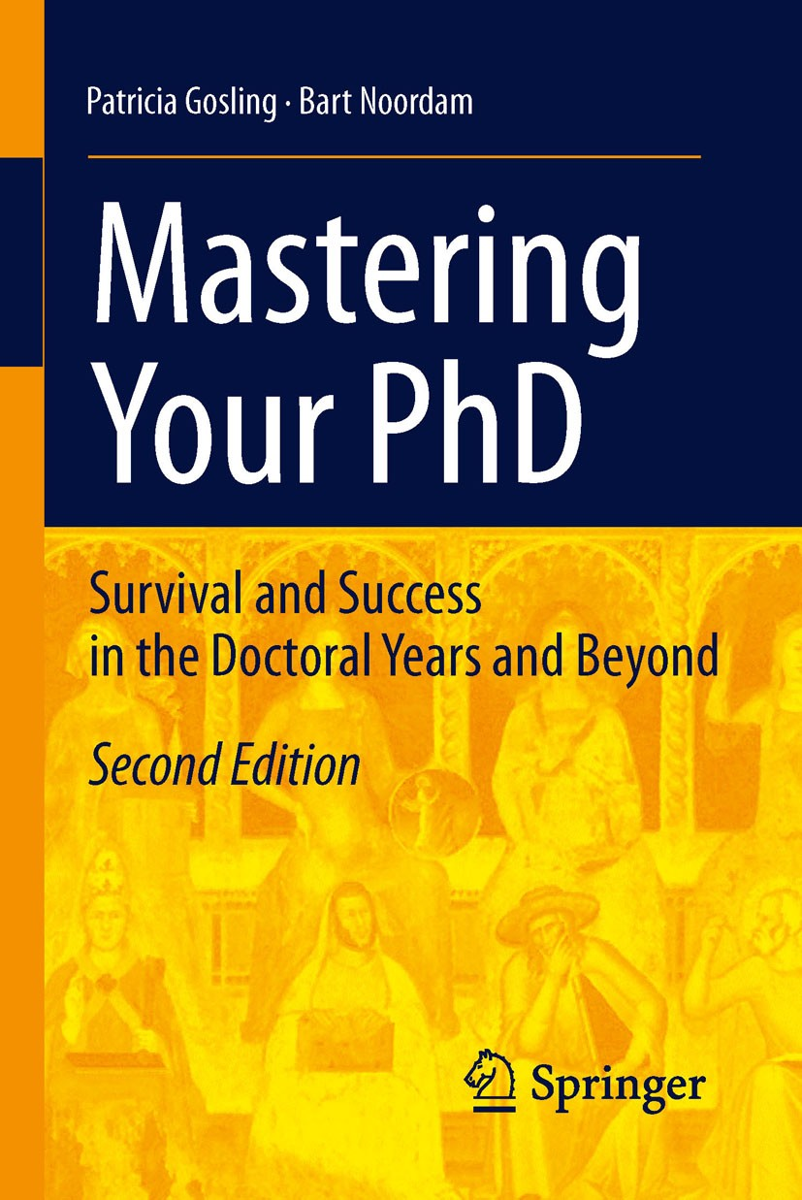
This book contains a huge amount of rules and advice on:
1. Writing a PhD thesis
2. Participation in scientific conferences
3. Writing articles for scientific journals
4. Conducting practical experiments and choosing scientific literature

Slide 3
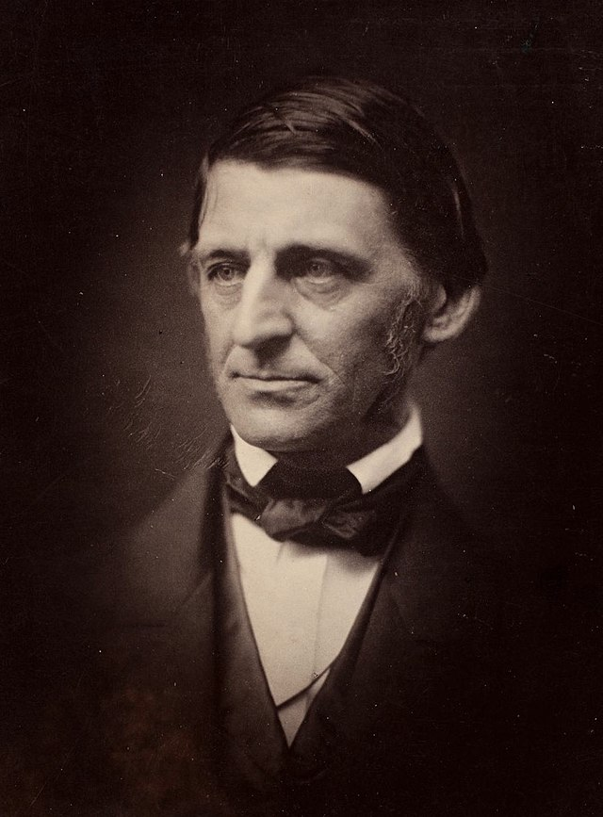
"Nothing great was ever achieved without
Enthusiasm."
Ralph Waldo Emerson (May 25, 1803 – April 27, 1882) - an American essayist, lecturer, philosopher and poet
Please, discuss and explain how you understand the meaning of this quote in the context of preparing a scientific study.
Time for discussion ~ 5 min

Slide 4
Writing a PhD thesis is a very long and laborious process.
Writing a PhD thesis involves not only conducting experiments, analyzing statistical information and reviewing scientific literature.
In your work, you will always communicate with other people – your scientific supervisor and graduate students of your department who have similar research topics.
In other words, all these people can be called your research group.

Slide 5
CHapter 1. Choosing a Research Group: Pluses and Pitfalls
In this chapter, the authors have identified and described five main types of research groups -- The Start-Up Group; The 'Up-and-Running' Group; The Small-but-Established Group; The Empire and The Gardener`s Group.
Each group has some features in the approach to their scientific work.
Also each group has some advantages and disadvantages and suits better for certain type of people.

Slide 6
Gardener's group analysis
1. Work with a supervisor who is well known in the scientific community
2. Freedom in making decisions
3. Opportunity to experiment with your research (topic, methods, statistics analysis, etc.)
4. Work without strict control
1. Low interest of the scientific supervisor in your research
2. Lack of a clearly developed work plan
3. High chance to waste your time on research
4. The risk of not realizing the potential of your research topic or changing the topic altogether

Slide 7
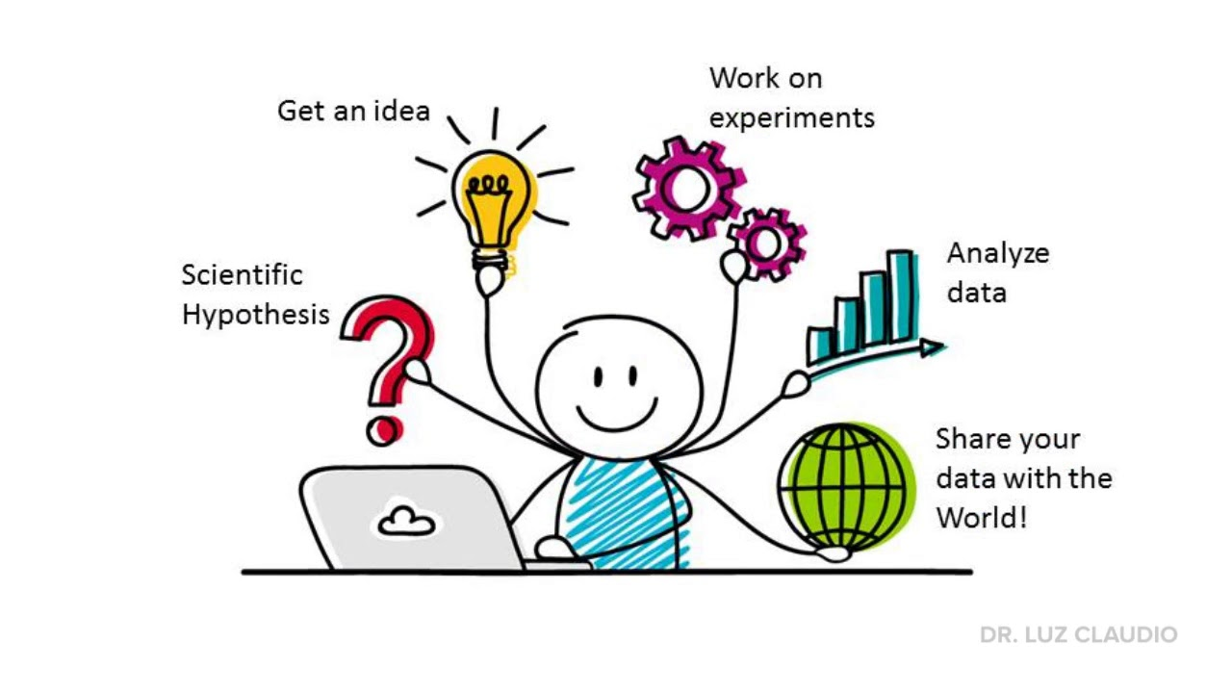
Gardener's group is the best for people who:
1. has not finally decided on the topic of his/her thesis
2. is not completely sure whether he/she wants to study in graduate school
3. wants to get a wide range of knowledge in several disciplines
4. wants to do all the research by himself/herself, but be sure that he/she will always receive advice from scientific supervisor

Slide 8
Divide into 4 groups and choose one of the research groups. Highlight the main advantages and disadvantages and for which people this group will be best.
Also, please enter the results of your work in the document (link in the chat).
Time for discussion ~ 15-20 min
1. The Start-Up Group
2. The 'Up-and-Running' Group
3. The Small-but-Established Group
4. The Empire

Slide 9
According to our previous discussion about research groups, please explain which group you consider to be the best for you in the context of your research topic.

