Slide 1
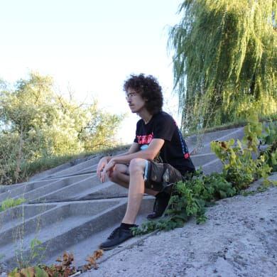
Developer Student Clubs
Brief Introduction
Ihor Melikhov
Ih01@i.ua
@ichzerowan
Volodymyr Bazylevych
bazvlamar@stu.cn.ua
@bazvlamar

Slide 2
“Developer Student Clubs are university based community groups for students interested in Google developer technologies. Students from all undergraduate or graduate programs with an interest in growing as a developer are welcome. By joining a DSC, students grow their knowledge in a peer-to-peer learning environment and build solutions for local businesses and their community.”
From DSC Website

Slide 3
Activities
Events we are going to organize
Workshops
Technical Discussions
Projects Development
Hackatons
Solution Challenge 2021
Communication & Experience Exchange

Slide 4
Technologies
Depend on Your Own Interests
Web
Cloud
AI/ML/Data Science
Mobile
Design
IoT
Any Other Technology
Notes:
Будут опросники

Slide 5
DSC Event Platform
Notes:
Обязательно зарегистрироваться

Slide 6
Core Team
Passionate about Community
DSC Lead
Core Team
Event Volunteer
Notes:
Форма для Core Team

Slide 7
Hosted Events
Just a Couple of Best
Data Serializtion. What, Why and How?
Introduction to Kotlin
Android Study Jams
Compilers. Behind the Run Button
Cross-Chapter Events

Slide 8
Club’s Summer Project
Horizon Modding Kernel

Slide 9
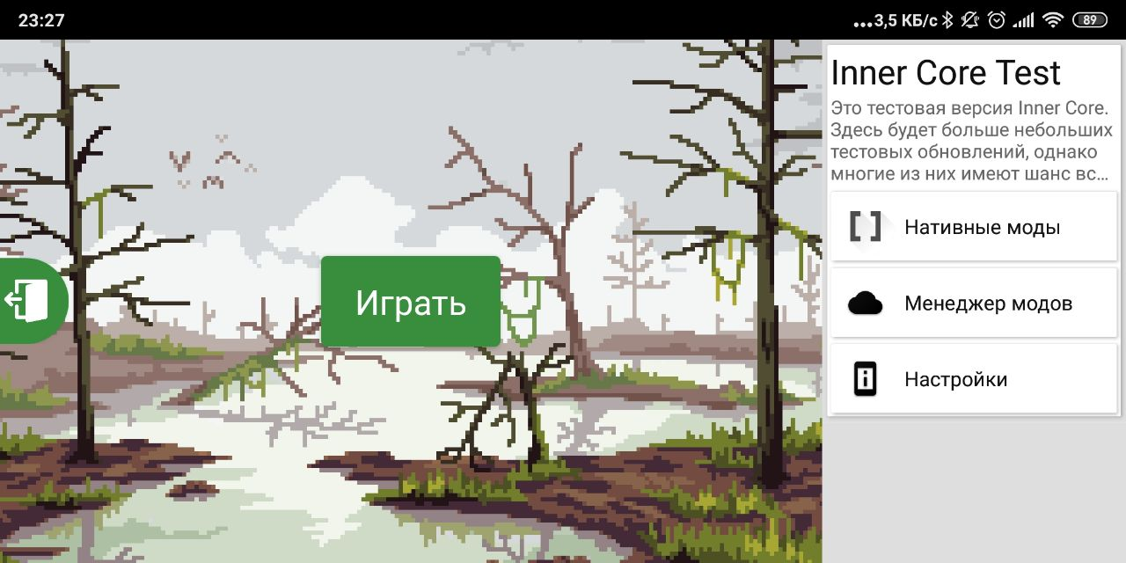
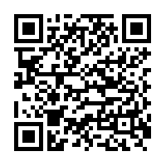
What is Horizon Modding Kernel
Horizon Modding Kernel is a flexible environment for game modding, and a modloader for Minecraft: Bedrock Edition.

Slide 10
Technologies Involved
Languages & Frameworks
Tools
Java/Android SDK
C/C++, Android NDK
JavaScript/Rhino
Python
TypeScript
Android Studio
Visual Studio Code + Plugins
Git/GitHub/GitLab
TypeScript/TypeDoc + Plugins
Trello

Slide 11
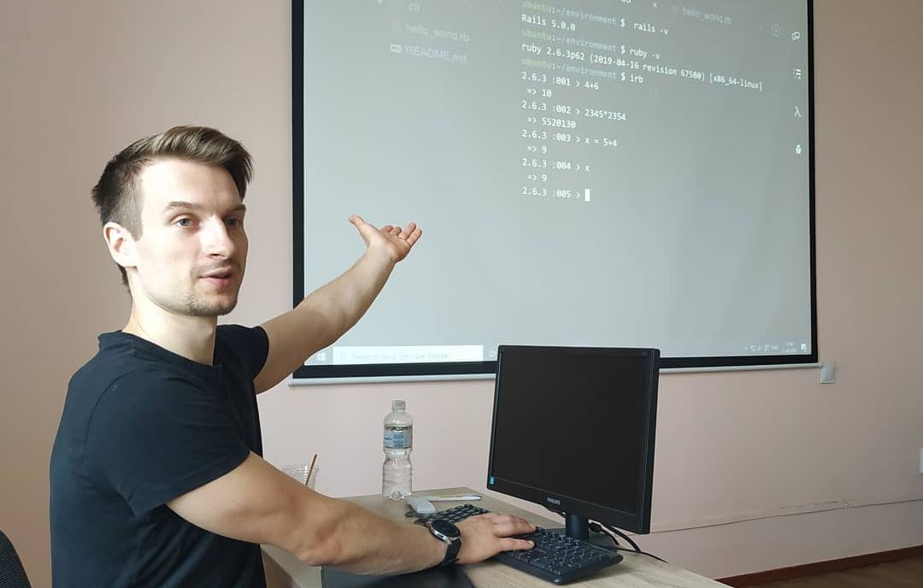
Ruby on Rails workshop
21/08/2020
Great workshop on Ruby on Rails for students from developer. In a little more than 5 hours, students were able to create their first small application.

Slide 12
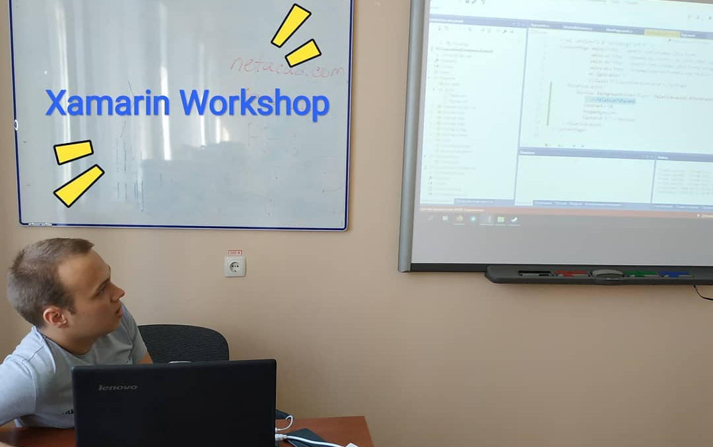
Xamarin Workshop
13/09/2020
Workshop for students by student about Xamarin Framework

Slide 13
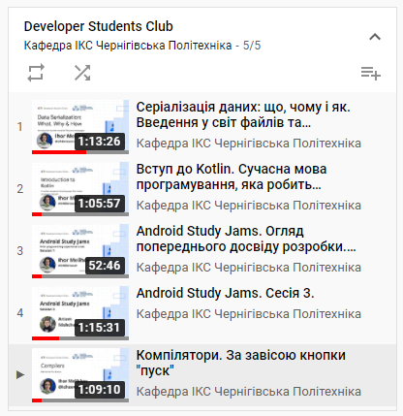
YouTube playlist
Records of Events
All records of club events you can find at department ICS channel https://www.youtube.com/channel/UCiBWJn4v6Mr0XVVYTBrRmLg

Slide 14
Thank You!
Ihor Melikhov Ih01@i.ua @ichzerowan
Volodymyr Bazylevych
bazvlamar@stu.cn.ua
@bazvlamar

